Slide 1
quiz & connections

Slide 2
1.What Operating system did Google develop ?
A.) Windows
B.) BlackBerry
C.) Android
D.) IOS OS

Slide 3
ANSWER:
Option C
Android

Slide 4
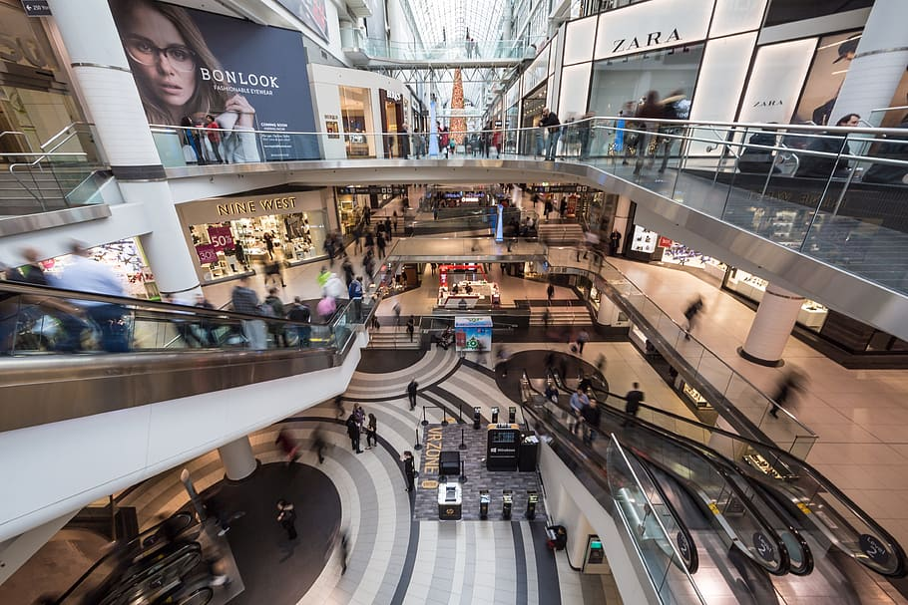

2. Guess the tech ?

Slide 5
ANSWER:
Universal Serial Bus
(USB)

Slide 6
3. Who is the Developer of Computer ?
A.) Henry Edward Roberts
B.) Charles Babbage
C.) Tim Berners-Lee
D.) None

Slide 7
ANSWER:
Option B
Charles Babbage

Slide 8

4. Which of these is not a peripheral, in Computer terms ?

Slide 9
ANSWER:
Mother Board

Slide 10
5. Which is the full-form of SD Card?
A.) Standard Digital Card
B.) Secure Disk Card
C.) Standard Device Card
D.) Secure Digital Card

Slide 11
ANSWER:
Option D
Secure Digital Card

Slide 12


6. It is a Temporary Storage

Slide 13
ANSWER:
Cache Memory

Slide 14
7. Which was the first Internet Search Engine ?
A.) Yahoo
B.) Google
C.) Archie
D.) Lycos

Slide 15
ANSWER:
Option C
Archie

Slide 16
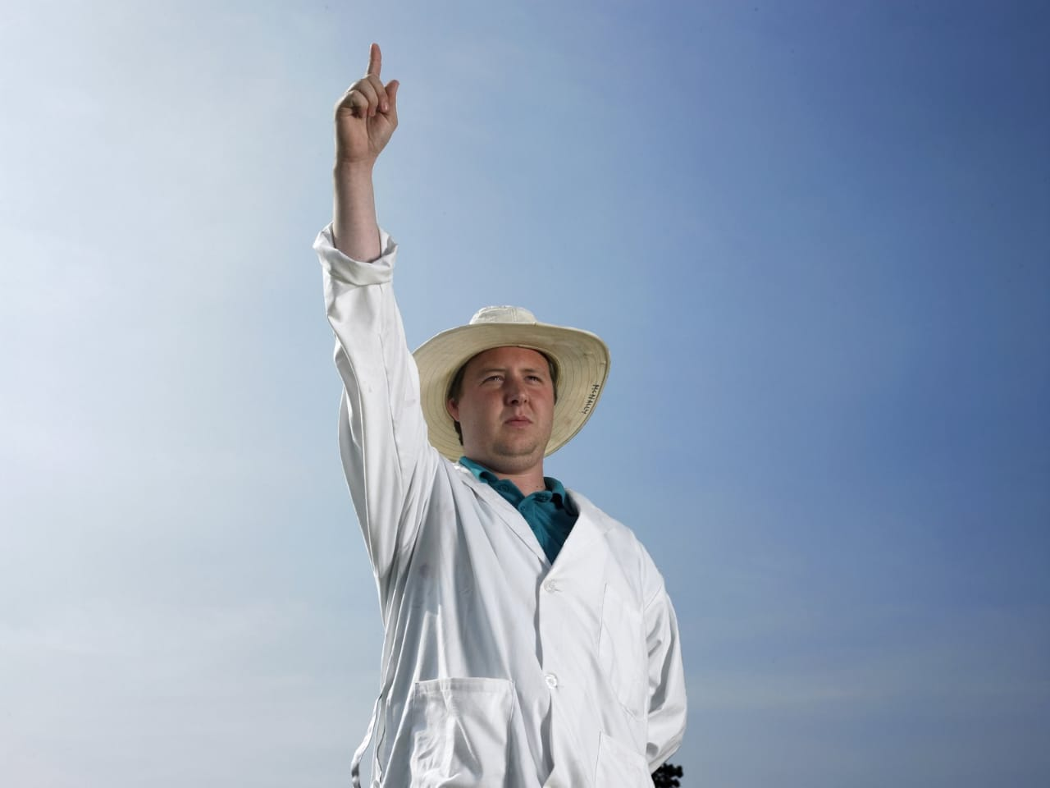

8. Microsoft office’s personal information manager is

Slide 17
ANSWER:
Outlook

Slide 18
9. What is the Full-form of COMPUTER ? A.) Commonly Operating Machine Purposely used for Technical and Educational Research B.) Commonly Operating Machine Particularly used for Technical and Educational Research C.) D.) None of the Above

Slide 19
ANSWER:
Option A
Uniform Resource Locator

Slide 20
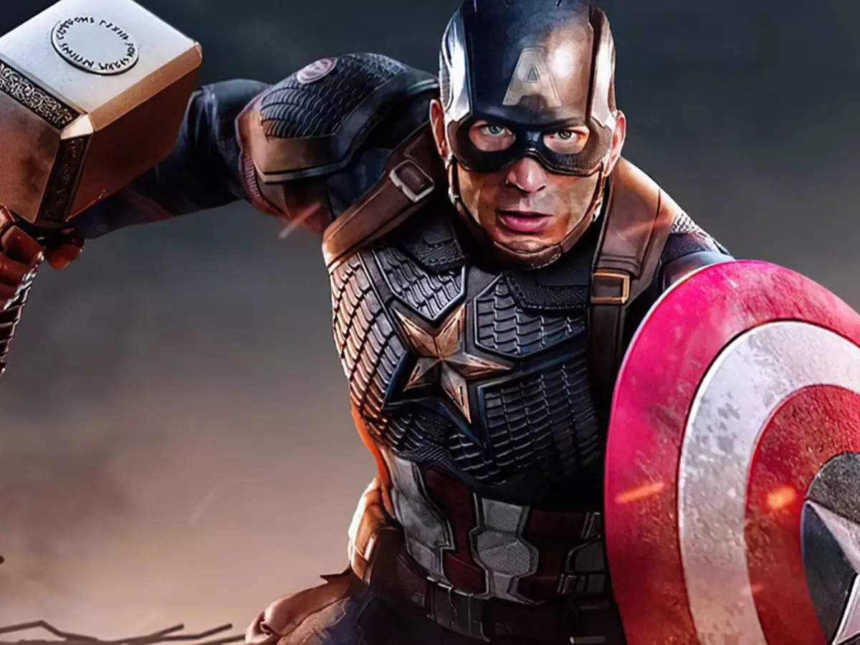

10. Your laptop has this

Slide 21
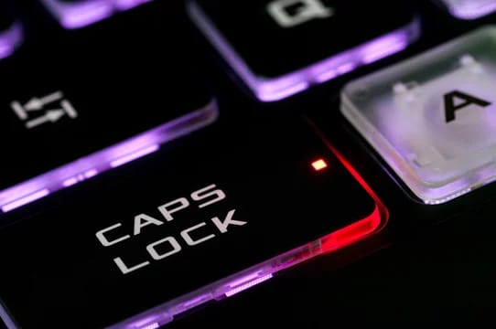
ANSWER:
Caps Lock

Slide 22
11. Who is the founder of Oracle?
A.) Lamb
B.) Larry Ellison
C.) James
D.) Karter

Slide 23
ANSWER:
Option B
Larry Ellison

Slide 24
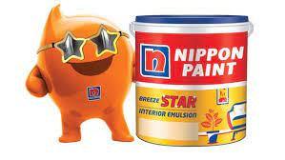
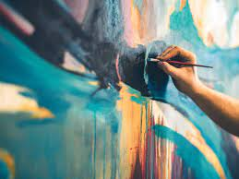
12. Which one of the following is not a special program in MS-office

Slide 25
ANSWER:
Paint Art

Slide 26
13. 1kb equal to _______?
A.) 1 MB
B.) 1024 bit
C.) 1000 byte
D.) 1024 byte

Slide 27
ANSWER:
Option D
1024 Byte

Slide 28


14. It is a Growing Community

Slide 29
ANSWER:
Code io

Slide 30
15. Who invented mouse?
A.) Charles Babbage
B.) Martin Cooper
C.) Douglas Engelbart
D.) Christopher Sholes

Slide 31
ANSWER:
Douglas Engelbart

Slide 32
15. Shortcut key of new folder creation ?
A.) F2
B.) Ctrl + N
C.) Ctrl + Shift + N
D.) Alt + Shift + N

Slide 33
ANSWER:
Option c
Ctrl + Shift + N

Slide 34
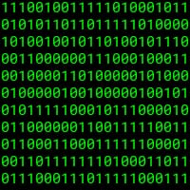

16. You know it.

Slide 35
ANSWER:
Binary Tree

Slide 36
17. Which of the following is not an example of an Operating System?
A. Windows 98
B. BSD Unix
C. Microsoft Office XP
D. Red Hat Linux

Slide 37
ANSWER:
Option C
Microsoft Office XP

Slide 38
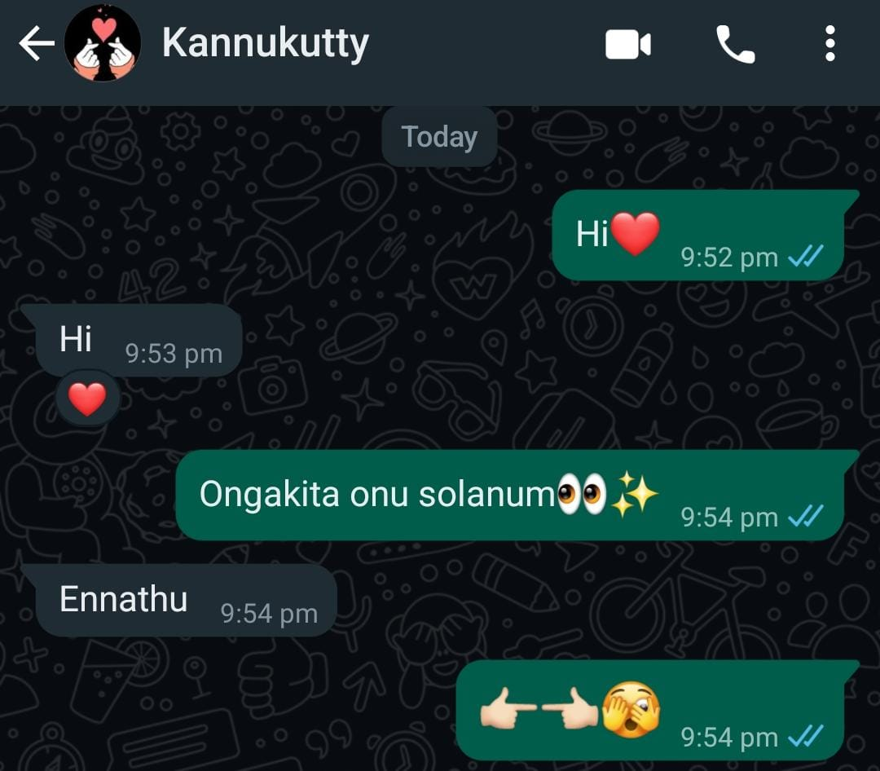
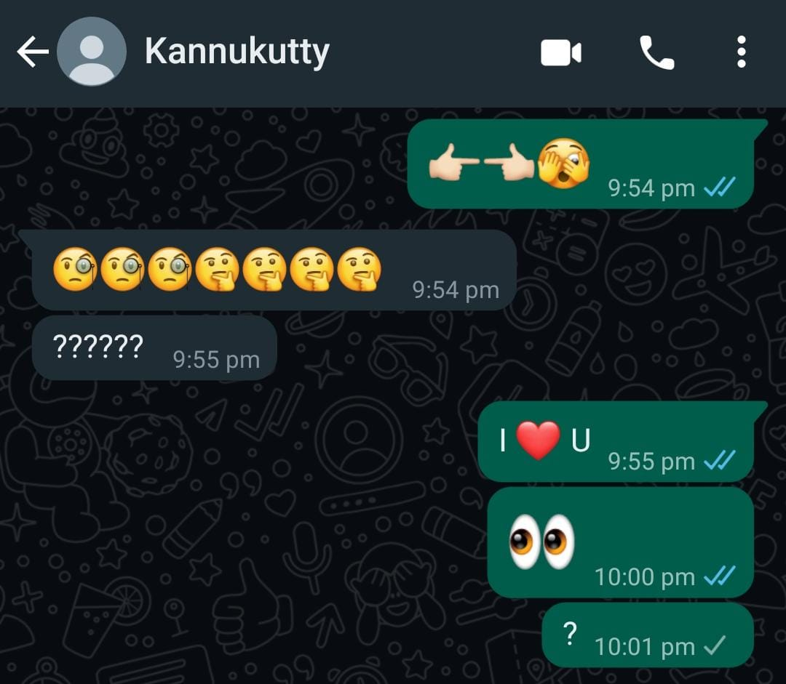
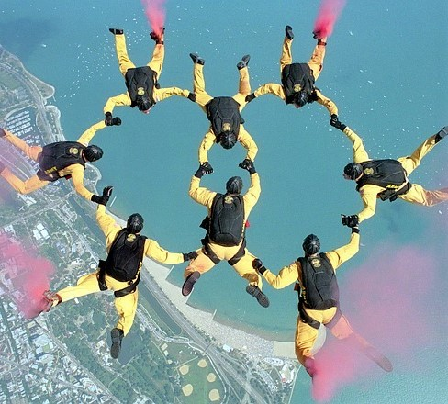
18. It is a Growing Technology in CS

Slide 39
ANSWER:
Block Chain

Slide 40
19. Which supercomputer is developed by the Indian Scientists?
A.) Param Padma
B.) Super 301
C.) Compaq Presario
D.) CRAY YMP

Slide 41
ANSWER:
Option A
Param Padma

Slide 42
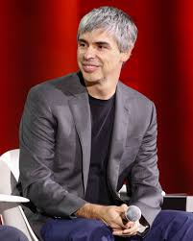
20. Guess the person.

Slide 43
ANSWER:
Larry Page

Slide 44



It is a Branch of computer Science

Slide 45
ANSWER: Natural Language Processing

Slide 46
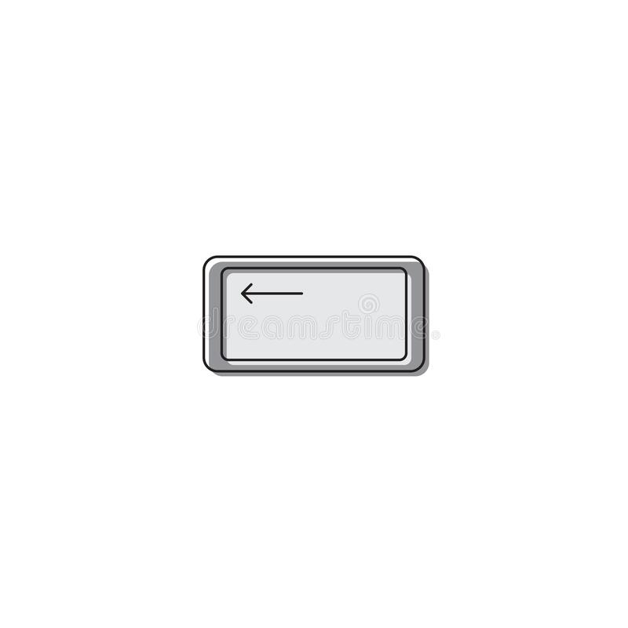
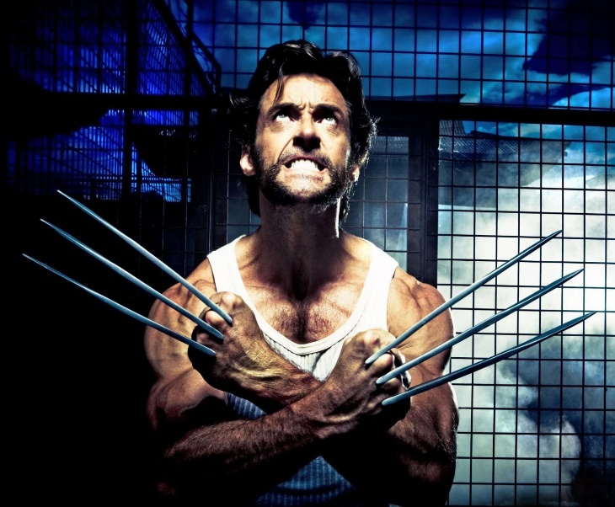
A Company

Slide 47
ANSWER:
Space X

Slide 48
Who is the current ceo of Microsoft ?
Satya nadella

Slide 49
The person below is the 1st computer programmer. Who is she ?
Ada lovelace

Slide 50
It is one of the open source software library for ai & ML ?
Ten-sir-flowchart
Tensorflow
Brother(nazriya) + chess + ing => processing
All + go(Man rans) + rhythm =>algorith,
Pi + juice => byjus (students learning platform)

Slide 51
Popular company ?
Google lens + O + va(come)
Lenovo
Vipe + bear = viber
V x a = ? + up arrow=> whatsapp
Pin + tear + East => pinterest
Linkedin => Link(Chain) + dins
2+ w + tear => Twitter
Action madam

Slide 52
Thank you

